Slide 1
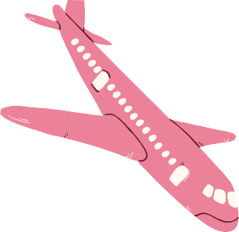
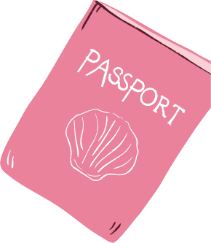
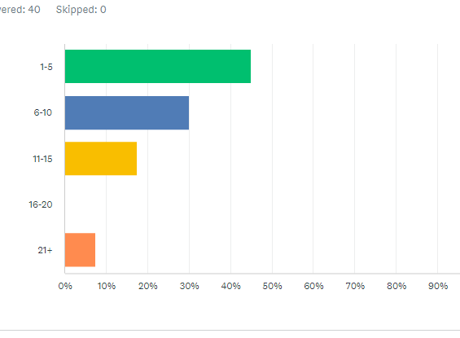
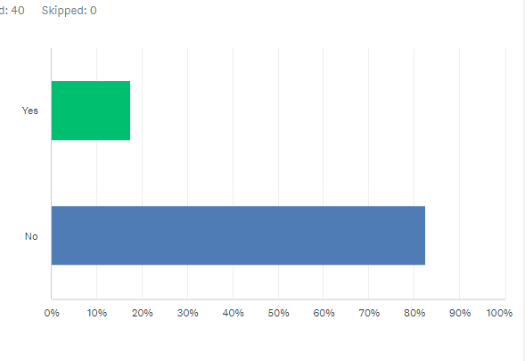



The Impact of Covid-19 on Travel
Did Covid-19 have an effect on travel? Will people continue to travel? Will their vaccination status effect future travel plans?
Pre-Covid Post-Covid
Point 1
Point 1
45% of those surveyed had visited between 1-5 states and 30% had visited between 6-10 states, before the pandemic.
87.5% of those surveyed plan to travel domestically after the pandemic.
Point 2
Point 2
87.5% of those surveyed had visited between 1-5 countries before the pandemic
70% of those surveyed plan to travel internationally after the pandemic.
Point 3
Point 3
U.S. domestic travel increased 1.7% from 2018
to a total of 2.3 billion person-trips in 2019.
82.5% of those surveyed will not let their vaccination status affect their future travel plans.
Number of states traveled to before the pandemic
Vaccination status affecting future travel
Facts
Facts
Travelers spent $242 billion on lodging, including hotels/motels/B&B, vacation homes and campgrounds, in 2019.
Travelers surveyed plan to stay in a hotel for their future travel.
References
1 .https://www.surveymonkey.com/stories/SM-XarE5lpZu0he0yNu5R9o5A_3D_3D/
2. Research_Fact-Sheet_US-Travel-and-Tourism-Overview.pdf(ustravel.org)

